Slide 1
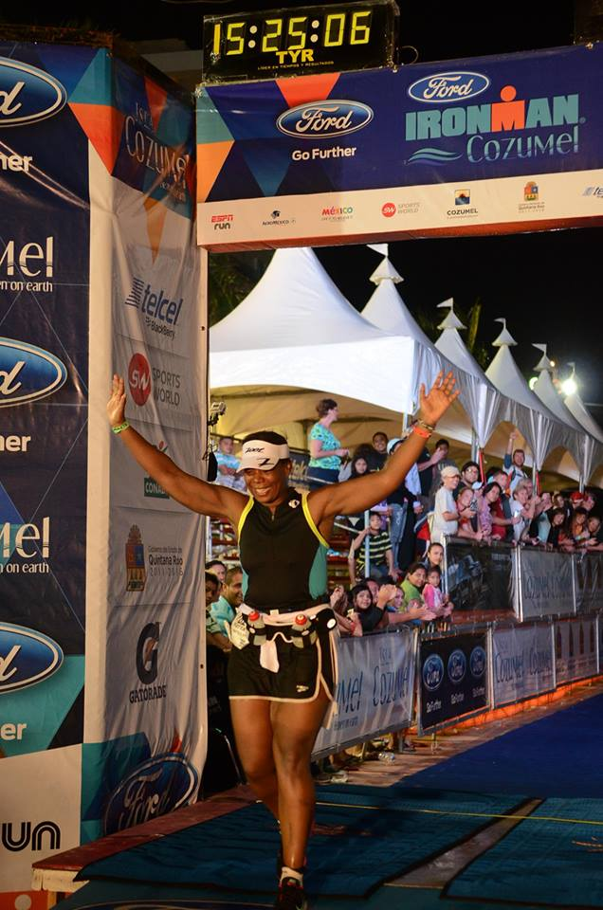
The Science of Faith:
How data tracking helped me become an Ironman!

Slide 2
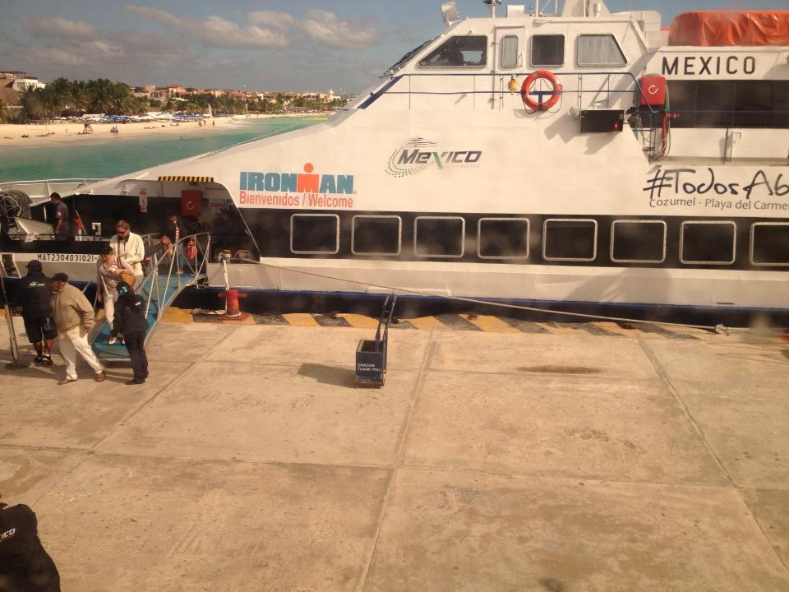
IRONMAN
2.4 Mile Swim
112-mile Bike
26.2-mile run
17 hours
Lifetime bragging rights!

Slide 3
WHAT I TRACKED
MY WEIGHT
MY SPEED
MY DISTANCE

Slide 4
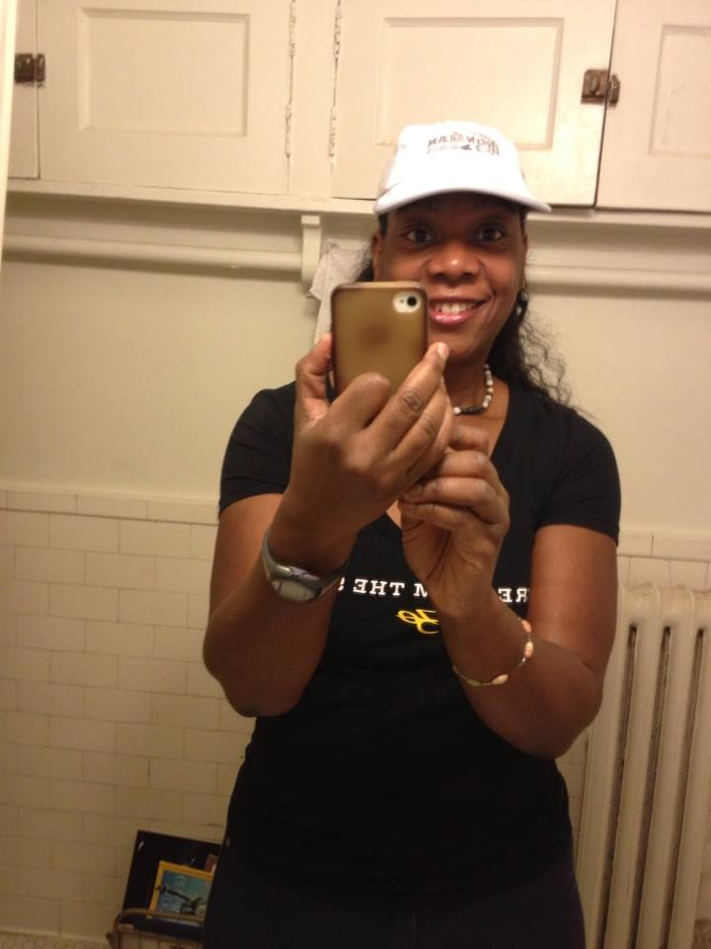
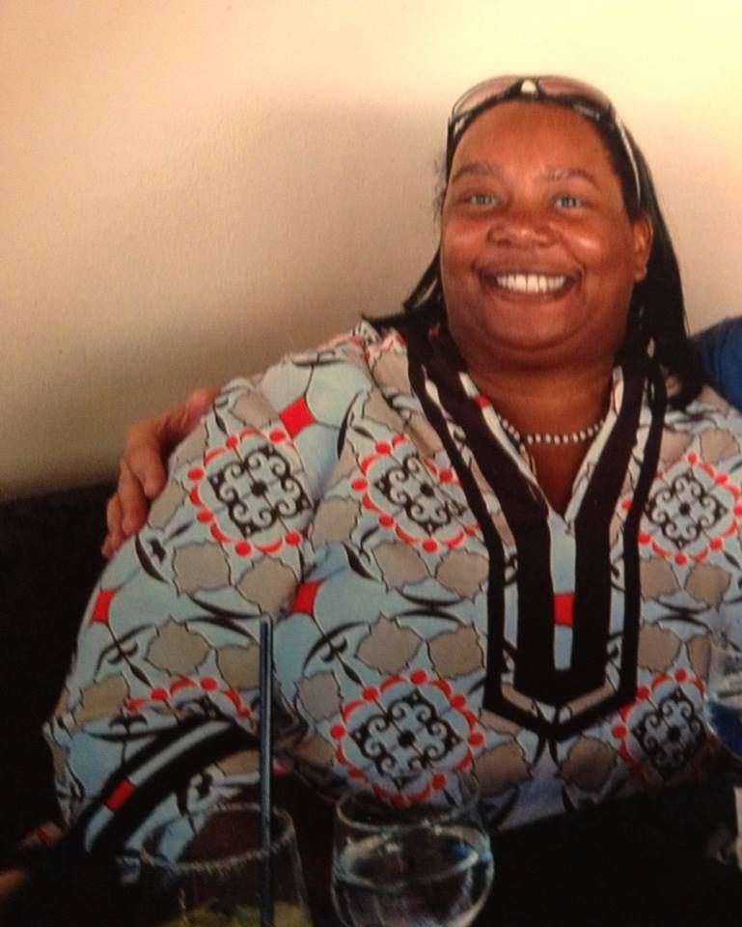

Slide 5
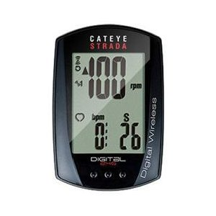
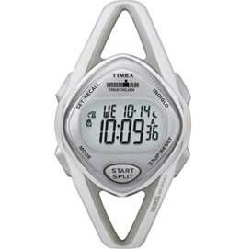
How Did I Do It?

Slide 6
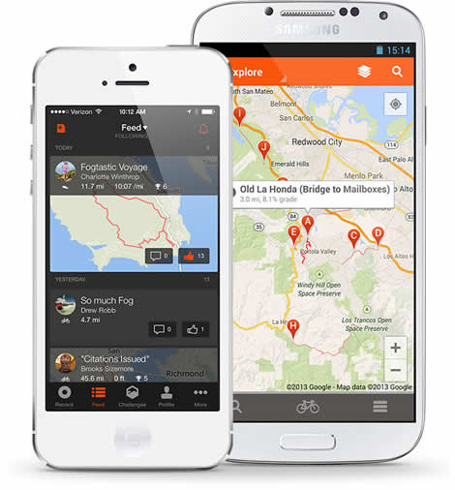

Slide 7
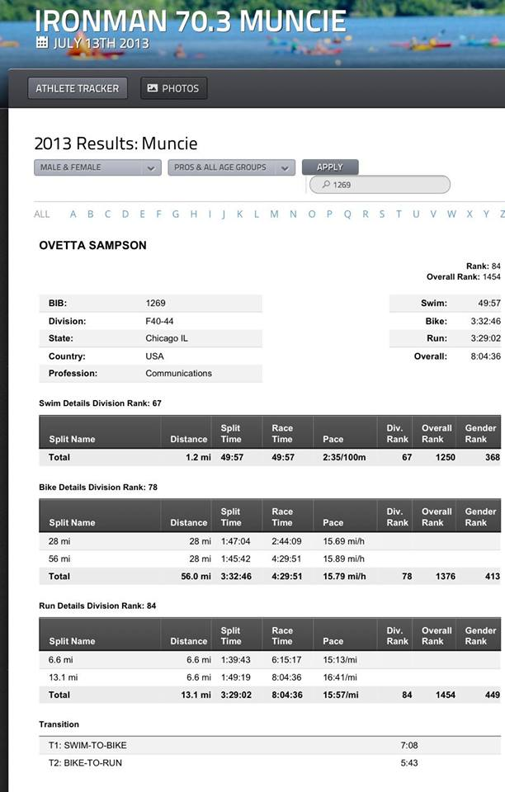
I WAS SLOW:
SWIM: 2.43/100m
BIKE:
12 mph
RUN:
16 min/mile

Slide 8
ABOUT ME
NEVER AN ATHLETE
STARTED TRIATHLONS IN 2004
DID SPRINTS, OLYS HALFIRONMANS
IN 2008 ATTEMPTED IM Couer D’ Alene missed the bike cutoff
Weighed 270 lbs in 2012

Slide 9
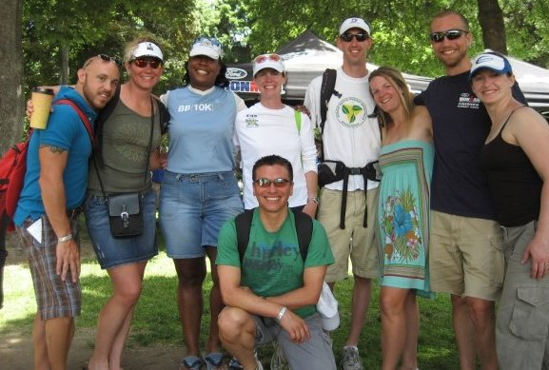

Slide 10
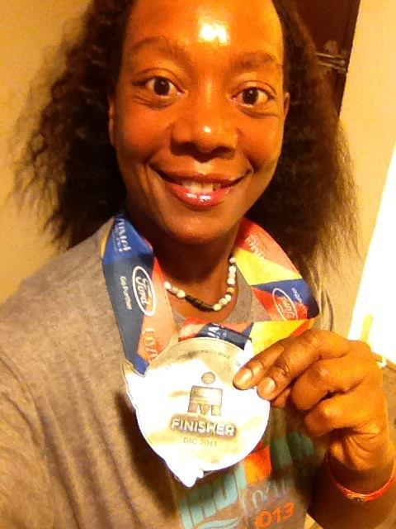

Slide 11
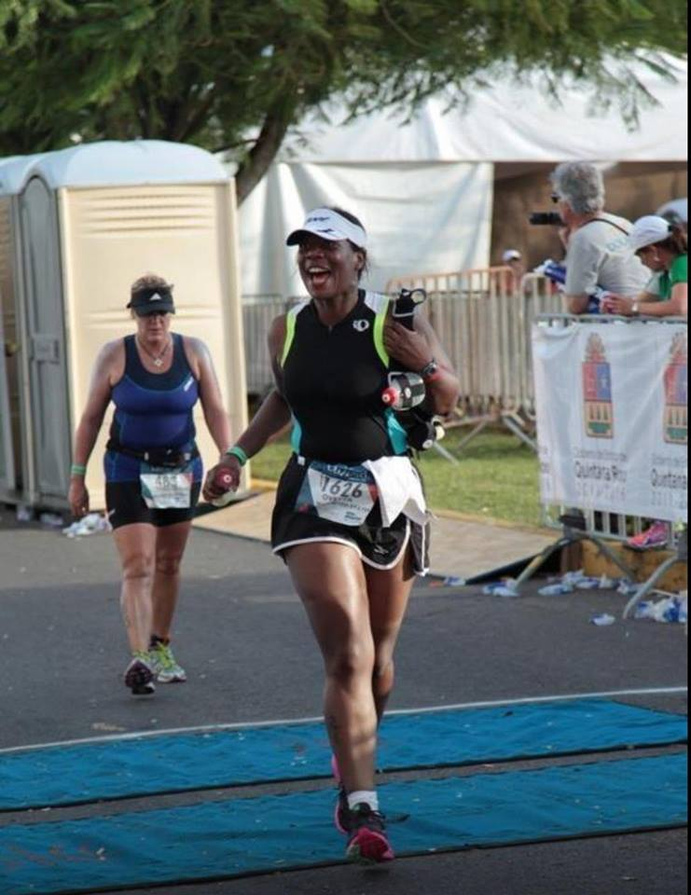

Slide 12
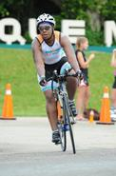
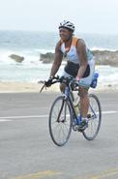
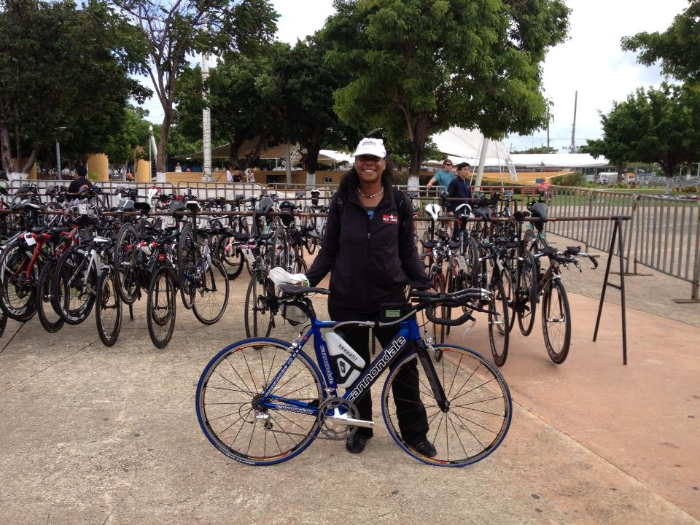
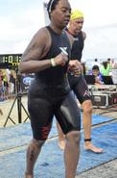

Slide 13
WHAT I LEARNED
METRICS MOVES THE MIND
THE BODY IS A MACHINE
MILESTONES ARE IMPORTANT
DATA IS CONTEXTUAL
ANYTHING IS POSSIBLE IF YOU SET THE RIGHT GOALS
FAITH WITHOUT DATA IS DEAD
Notes:
The Great Commission/James verse

